Slide 1

PGB Session
29 May 2025
Ms. Katherine Escobar
NIEMOpen Project Governing Board Chair

Slide 2
CALL TO ORDER
Called to order the regular virtual meeting of the NIEMOpen Project Governing Board at 2 PM, 29 May 2025.
2

Slide 3
VENUE
PGB Meeting
29 May 2025
Virtual Meeting 2-4 PM EST
– Virtual: MS TEAMS
Microsoft Teams 29 May 2025 PGB Meeting
Microsoft Teams 29 2025 PGB Meeting
Join the meeting now
Meeting ID: 993 272 665 665
Passcode: yQ6Cz6Wh
Dial in by phone
+1 410-874-6749,,743104072# United States, Odenton
Find a local number
Phone conference ID: 743 104 072#
PGB Minutes & documents: https://github.com/niemopen/oasis-open- project/tree/main/pgb-meeting-minutes

Slide 4
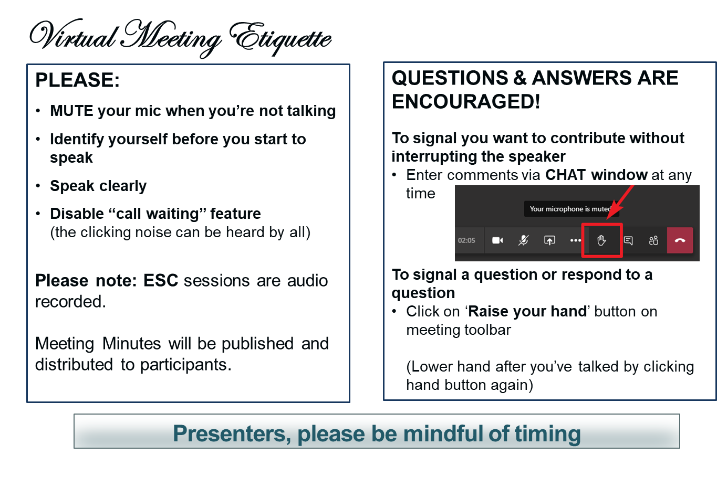
MAKING THE MOST OF OUR SESSION

Slide 5
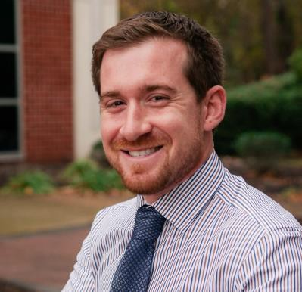
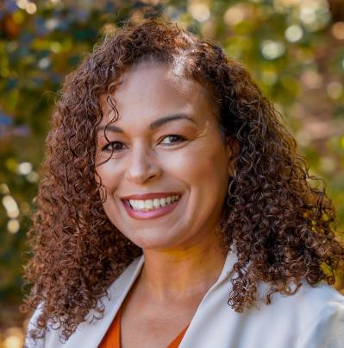
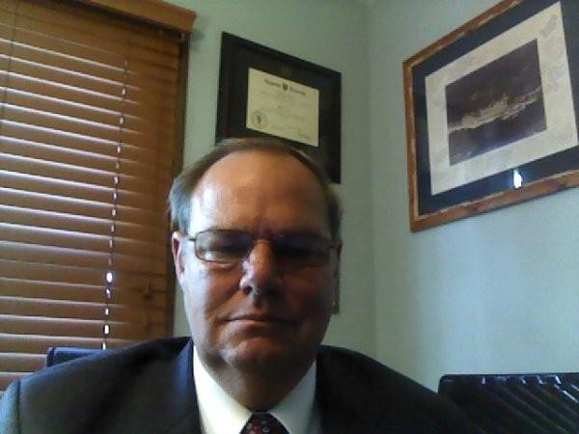
NOTE TAKER
The PGB Executive Session is being recorded on MS TEAMS. A link to the recording will be provided and meeting minutes will be posted on the NIEMOpen Git Repo once approved: https://github.com/niemopen/oasis-open-project/tree/main/pgb-meeting-minutes
Meeting support, note takers: Aubrey Beach
aubrey.l.beach.ctr@mail.mil
Shunda Louis
shunda.r.louis.ctr@mail.mil
Stephen Sullivan
stephen.m.sullivan14.ctr@mail.mil

Slide 6
ROLL CALL
PGB Voting Members (11):
All Purpose Networks (APN)
Bureau of Justice Statistics (BJS)
Department of Defense Joint Staff J6 (DoD JS J6)
Department of Homeland Security Science & Technology (DHS S&T)
Equivant
Georgia Tech Research Institute (GTRI)
Integrated Justice Information Systems Institute (IJIS)
Commonwealth of Virginia, Office of Data Governance and Analytics (ODGA)
Criminal justice Information Systems Division (CJISD), Federal Bureau of Investigation
National Association for Justice Information Systems (NAJIS)
National Institute of Justice (NIJ)
PGB Expert Voting Members (3)
NBAC TSC
NTAC TSC
NMO TSC
PGB Expert NON-Voting Members (4)
Notes:
Voting Members
Mr. Jim Herbert - All Purpose Networks (APN)
Ms. Erica Smith - Bureau of Justice Statistics (BJS)
Ms. Katherine Escobar - Department of Defense Joint Staff J6 (DoD JS J6)
Ms. Christina Bapst-Stump - Department of Homeland Security Science & Technology (DHS S&T)
Mr. Gary Egner - Equivant
Mr. John Wandelt - Georgia Tech Research Institute (GTRI)
Ms. Maria Cardiellos - Integrated Justice Information Systems Institute (IJIS)
Mr. Payton Lamb - Commonwealth of Virginia, Office of Data Governance and Analytics (ODGA)
Ms. April Michell - Criminal justice Information Systems Division (CJISD), Federal Bureau of Investigation
Mr. Tom Welch - National Association for Justice Information Systems (NAJIS)
Ms. Erin Partin - National Institute of Justice (NIJ)
Expert Voting Members
NBAC TSC - Mr. Thomas Krul (National Defence Canada)
NTAC TSC - Dr. Scott Renner (MITRE)
NMO TSC – Ms. Beth Smalley (Joint Staff J6 DSD)
PGB Expert Non-Voting Members(4)
NBAC TSC – Mr. Kamran Atri (A4Safe),
NBAC TSC Mr. Paul Wormeli
NTAC TSC – Mr. Brad Bolliger (EY)
NMO TSC- Ms. Darcy Staley (JS J6)

Slide 7
ANNOUNCEMENTS
PGB approved NIEMOpen NDR v6.0 PSD01
Submitted for Publication to OASIS Library
PGB approved NIEM Model Version v6.0 PS02
Submitted for Publication to OASIS Library
Next steps
Identify & approve 3 Statement of Use
Welcome All Purpose Networks, Inc. (APN) Sponsor – Mr. Jim Herbert
Welcome Forensics Domain/Sub-Committee
Hackathon delayed

Slide 8
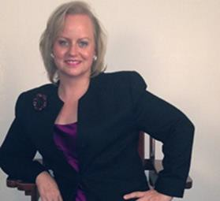
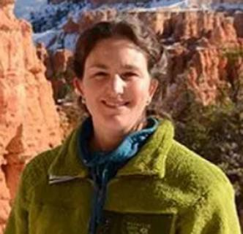

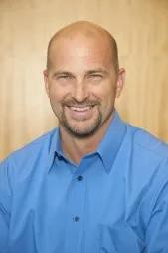
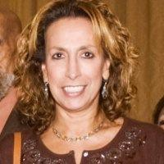
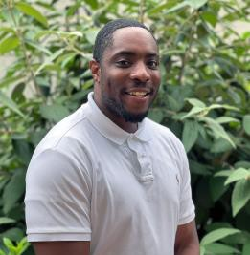
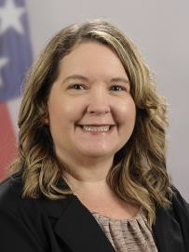
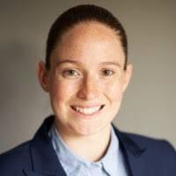
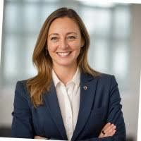
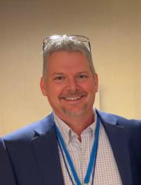
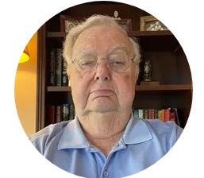
PGB SPONSOR VOTING MEMBERS
Ms. Katherine Escobar
PGB Chair Deputy Division Chief, Data and
Standards Division at Joint Staff J6 and NIEM Managing Director
Ms. Christina Bapst-Stump
Science and Technology Directorate,
US Department of Homeland Security
Mr. Gary Egner Director Business Development, Equivant
Mr. John Wandelt Principal Research Scientist, Georgia Tech Research Institute
Ms. Maria
Cardiellos Executive Director Integrated Justice Information Systems Institute
Mr. Payton Lamb
Data Engineer Commonwealth of Virginia Office of the secretary of Administration
Office of Data Governance and Analytics
Ms. April Mitchell
FBI It Specialist and Technical Lead of Data Standards in the Criminal Justice Information Services (CJIS) Division
Ms. Erin Partin Data Scientist, Office of the Principal Deputy Director, National Institute of Justice (NIJ)
Ms. Erica Smith Data Scientist, Unit Chief – Law Enforcement Incident-Based Statistics Unit, Bureau of Justice Statistics (BJS)
Mr. Tom Welch Director of Information Technology OHIO HIDTA –
Including Northern KY & Western PA
Mr. James T. Herbert
Company Advisor, All Purpose Networks, Inc. (APN)
Notes:
Welcome Jim Herbert representing All Purpose Networks, our newest sponsor.
Jim, would you like to say a few words

Slide 9
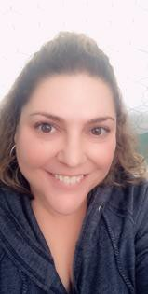
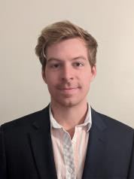
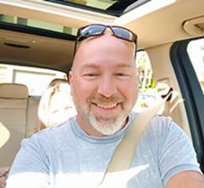
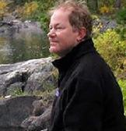
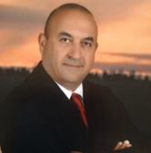
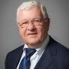
PGB EXPERT VOTING MEMBERS & NON-VOTING MEMBERS
PGB EXPERT VOTING MEMBERS
Technical Steering Committees
PGB EXPERT NON-VOTING MEMBERS
Technical Steering Committees
Mr. Kamran Atri Co-Chair, NIEM Business Architecture Committee TSC
Mr. Paul Wormeli Co-Chair, NIEM Business Architecture Committee TSC
Mr. Brad Bolliger Co-Chair, NIEM Technical Architecture Committee TSC
Mr. Thomas Krul Co-Chair, NIEM Business Architecture Committee TSC
Ms. Beth Smalley Co-Chair, NIEM Management Organization TSC
Dr. Scott Renner Co-Chair, NIEM Technical Architecture Committee TSC

Slide 10
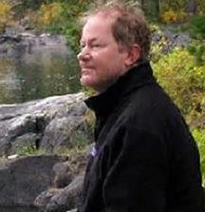
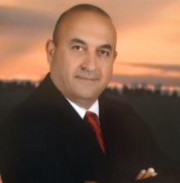
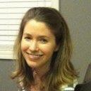
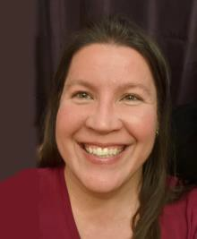
NMO, NBAC, & NTAC TSC CO-CHAIRS & OASIS MAINTAINERS
TSC | Approved (TSC CHAIRS)
NMO TSC | Ms. Darcy Staley & Ms. Beth Smalley
NBAC TSC | Mr. Kamran Atri & Mr. Thomas Krul, Mr. Paul Wormeli
NTAC TSC | Dr. Scott Renner & Mr. Brad Bolliger
GitHub Repos | Primary | Alternates
NIEM Open | Ms. Christina Medlin, Mr. Aubrey Beach | Mr. Tom Carlson, Ms. Shunda Louis, Mr. Steve Sullivan (pgb-minutes)
NTAC-Admin | Dr. Scott Renner, Mr. Brad Bolliger | Mr. Aubrey Beach, Mr. Tom Carlson, Mr. Jim Cabral, Ms. Christina Medlin, Ms. Shunda Louis
NBAC-Admin | Mr. Steve Sullivan, Mr. Aubrey Beach | Ms. Shunda Louis, Ms. Christina Medlin
NMO-Admin | Ms. Darcy Staley, Mr. Aubrey Beach | Mr. Steve Sullivan, Ms. Shunda Louis
NTAC
TSC
NBAC
TSC
NMO TSC
Christina Medlin
Aubrey Beach Dr. Scott Renner Brad Bolliger
10
Steve Sullivan
Darcy Staley

Slide 11
PROPOSED 29 MAY 2025 PGB AGENDA
Call to Order
Admin
TEAMS Link
Meeting Etiquette
Note Takers
Roll Call & Introductions
Announcements
PGB Voting Members (Sponsors) & PGB Expert Voting Members (TSCs) & PGB Non-Voting Members (TSC Co-Chairs)
TSC Co-Chairs & NIEMOpen Maintainers
Approval of Agenda
Around-the-Horn – PGB Voting Members
Approval of Meeting Minutes from 30 January 2025
OASIS Staff / NIEMOpen Administrator
Comments
Q1 2025 Financial Snapshot – Cathie Mayo (OASIS)
Sponsor Update – Rita Petti/ Holly Peterson
CY 2025 Tasks
22 May Webinar Recap – Paul Wormeli
8 Oct Reveal Summit Update
April16-17 TSC Meeting Recap
Training/LMS Update – Aubrey Beach
TSC Working Group
Forensics Domain/Subcommittee Presentation
BREAK
Motions
Motion to authorize $ 1000 from the NIEMOpen general fund for Excellence Awards and “swag” at the NIEMOpen Reveal on 8 October 2025.
Motion to authorize $ 1500 from the NIEMOpen general fund for refreshments, snacks & video services at the NIEMOpen Reveal on 8 October 2025.
Motion to authorize $100K from the NIEMOpen general fund to procure technical services under the INDEPENDENT CONTRACTOR AGREEMENT between OASIS Open and Georgia Tech Applied Research Corporation.
Rationale for Tech Support Services
Draft Work Order Tasks
Motion to authorize $ 2100 from the NIEMOpen general fund for purchase of Yoast ($100/annual) and Constant Contact and Marketing ($2000/annual) subscriptions.
Motion to advance the NIEM Naming & Design Rules (NDR) v6.0 Project Specification Draft 01 (PSD01) to a Project Specification (PS).
Motion to identify 3 Statements of Use (SoU) for Model Version 6.0 PS02 and submit SoUs to the PGB.
Co-Chair Discussion /Updates
NTAC Update – Mr. Brad Bolliger & Dr. Scott Renner
NBAC Update – Thomas Krul
NMO Update – Transition - Beth Smalley
Next Meeting Schedule
Other Business/Discussion
Questions/Adjourn

Slide 12
APPROVAL OF AGENDA
Chair: A Draft Agenda for the NIEMOpen 29 May 2025 Project Governing Board (PGB) Meeting was provided to PGB Voting Members as a readahead.
Chair: Are there any recommended changes to the agenda as distributed?
Chair: If there are no (further) changes, the agenda stands approved as
(corrected).
?
Approve
Approve as Corrected

Slide 13

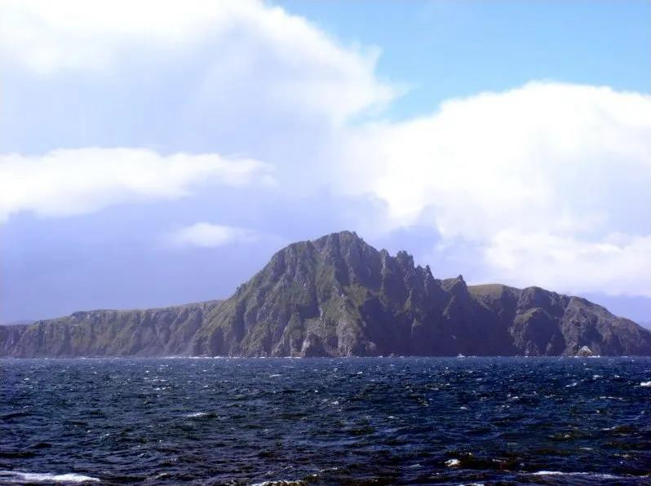
PGB MEMBERS: AROUND-THE-HORN

Slide 14
APPROVAL OF 30 January 2025 PGB MINUTES
Chair: A Draft of the NIEMOpen 30 January 2025 PGB meeting minutes ((FINAL) NIEMOpen PGB Meeting Minutes 30 JAN 2025 v3 5-8-2025.pdf) was provided to the PGB Voting/Expert Voting Members as a readahead: Please let me know now if you found any errors: https://github.com/niemopen/oasis-open-project/tree/main/pgb-meeting-minutes/2025/30-Jan-25
Chair: Are there any corrections to the minutes as distributed?
Chair: If there are no (further) corrections, the minutes stand approved as distributed (corrected).
?
Approve
Approve as Corrected

Slide 15
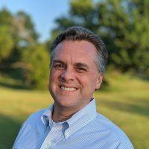
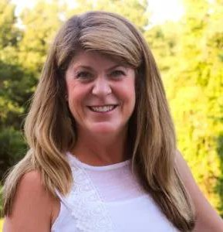
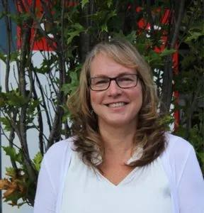
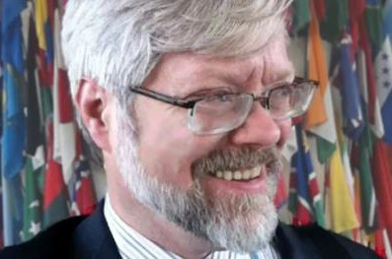
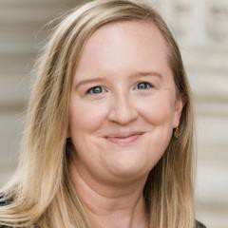
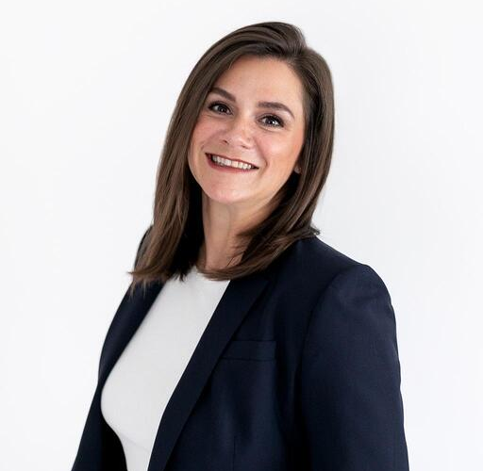
OASIS STAFF
Mr. Jim Cabral – Interim Executive Director
OASIS
Ms. Cathie Mayo – OASIS Chief Financial Officer
Mr. James Bryce Clark –
OASIS General Counsel
Ms. Jane Harnad – OASIS Head of Events
Ms. Kelly Cullinane – OASIS Senior Director of Standards Development
Ms. Rita Petti – OASIS Director
of Business Development and
Partnerships.

Slide 16

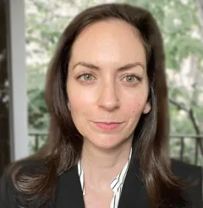
OASIS STAFF
Ms. Holly Peterson – OASIS Business Development Manager
Ms. Irene Heller – OASIS Community and Member Engagement Coordinator

Slide 17
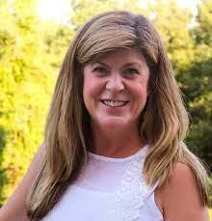
CY 2025 Q1 FINANCIALS
Ms. Cathie Mayo – OASIS Chief Financial Officer

Slide 18
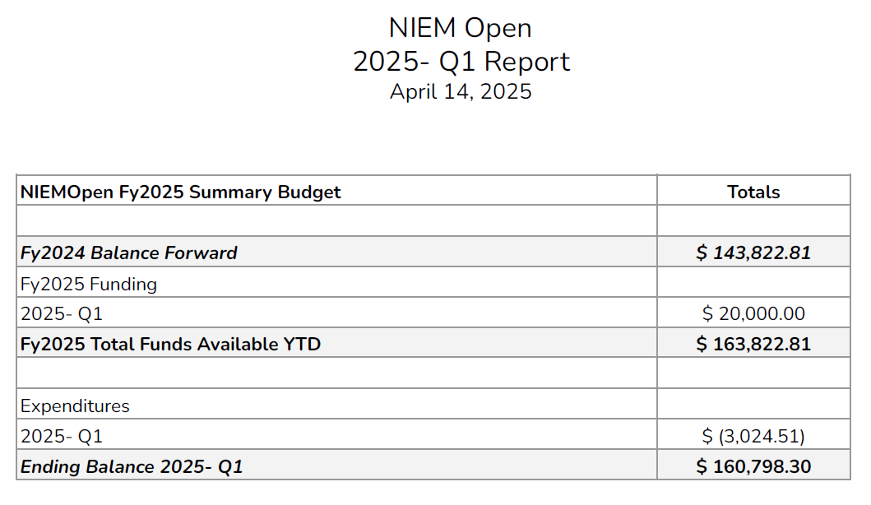

Slide 19
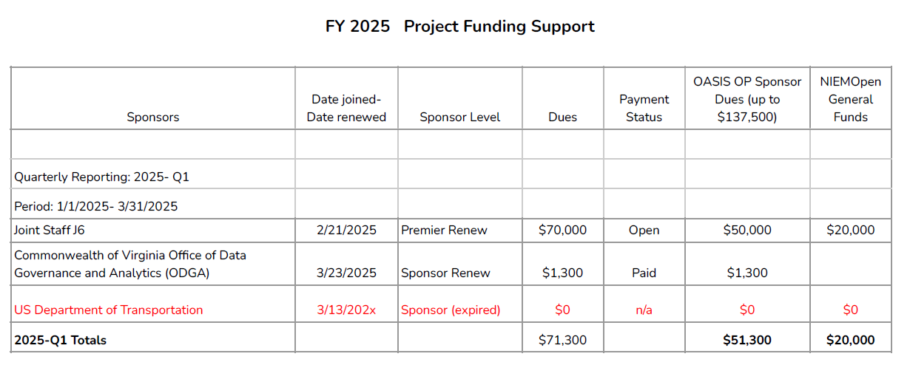

Slide 20
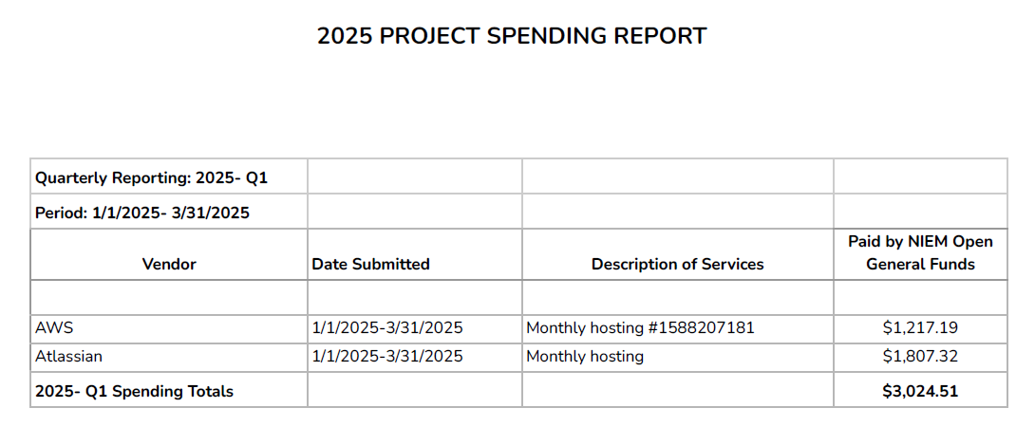

Slide 21




























NIEMOpen Current Sponsors
11 Sponsors, 3 Premier
Sponsors
JS J6
DHS S&T
CJIS (FBI)
GTRI
Equivant
NAJIS
BJS
IJIS
NIJ
APN
ODGA (Virginia)
Premier
Premier
Premier
All Purpose Networks, Inc.
Sponsors in the Offing
DHS
OBIM
Office of Standards
Department of National Defense

Slide 22

CY 2025 NIEMOPEN PLANNING
Complete
NIEMOpen NDR v6.0 Project Specification Draft (PSD01) Approved
NIEMOpen NDR v6.0 PSD01 Approved
Update Training Materials reflecting Model v6.0 PS and NDR v6.0 PSD01
Incorporate training updates into LearnPress LMS & test
IOC API 2.0 User tools
Conduct 22 May Webinar
Onboard Forensics Domain/ Sub-Committee
Conduct NBAC, NTAC & NMO Workgroup offsite (16-17 April 2025)
Planned/ In Progress 2025
Identify & approve 3 Statements of Use for Model Version 6.0 PS
Submit NIEM Model v6.0 PS02 as a Candidate OS
Start Model v6.1
Advance NDR PSD01 to a PS
Complete API 2.0 model management tasks
Complete transfer of github.io files to NIEMOpen
Recruit 3 new Premier Sponsors
Plan & Conduct 2025 Symposium/Summit
Onboard Analytical Laboratories Domain\ Sub-Committee
Onboard Identity Management Domain/ Sub-Committee
Stand-up NBAC. NTAC, NMO Workgroup
Propose funding & tasks for CY 2025 developer hours
Recurring/On-Going
Identify Potential Sponsors/Conduct Outreach
Conduct Synch w/ OASIS Staff as needed
Obtain Contributor License Agreements

Slide 23
22 May WEBINAR RECAP
Agenda
1:00 Welcome and relevance - Maria Cardiellos (Executive Director, IJIS)
1:10 Introduction to the new NIEMOpen – Katherine Escobar (PGB Chair)
1:20 The New NIEM
CMF/CMF Tool ( includes demo) – Dr. Scott Renner (NTAC Co-Chair)
API 2.0 – Dr. Scott Renner (NTAC Co-Chair)
NDR 6.0 and toolkit + future updates – Dr. Scott Renner (NTAC Co-Chair)
1:50 Future Architecture, role of Ontologies, and AI - Brad Bolliger (NTAC Co-Chair)
2:00 The future of NIEMOpen with OASIS – Jim Cabral (Acting Director OASIS)
2:10 NIEM on the ground – Tammi Blackstone, JD (Iowa Integrated Justice Coordinator), Jim Pingel (Mission Critical Partners)
2:20 New dimensions for NIEMOpen in ontologies – Paul Wormeli, Carolyn Staats (Director of Innovation, Sonoma County), Jodi Leveque (Assistant CEO, Sonoma County Courts)
2:30 The future, plans and resources – Katherine Escobar (PGB Chair)
2:35 Open Discussion/Q&A (Katherine Escobar, Maria Cardiellos, NBAC and NTAC Co-chairs)
3:00 Close
Webinar conducted 22 May 2025
Hosted by IJIS
Highlighted recent advances: model, tooling, NDR
Focus on future

Slide 24

The NIEMOPEN Future
Why Choose NIEMOpen
Recognized Standard
Flexible & Adaptable Architecture
Robust AI Support
Host for Emerging Technologies
World Class Accredited Training
Cutting Edge Tools
International Footprint
Industry and Government Choice
Expanding Community of Interest
Sustainable Infrastructure & Growth

Slide 25
ROI of Open Standard Investment
Direct Returns: Increased interoperability, reduced costs, vendor diversity.
Indirect Returns: Spurs innovation, enhances security, accelerates compliance.
Example: NIST & FIPS investment led to globally adopted cryptographic standards.
Notes:
This chart illustrates different categories of ROI — direct cost savings, innovation gains, and national security outcomes.

Slide 26

Conclusion
Investing in NIEMOpen isn’t a cost — it’s a strategic advantage.
Now is the time for Federal, State, Local and Industry leadership.
Let’s shape the future, not just comply with it.
Sponsor NIEMOpen
Notes:
Final reminder: leadership in open standards is essential for digital sovereignty and economic competitiveness.

Slide 27
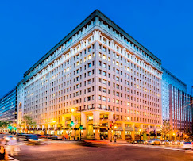

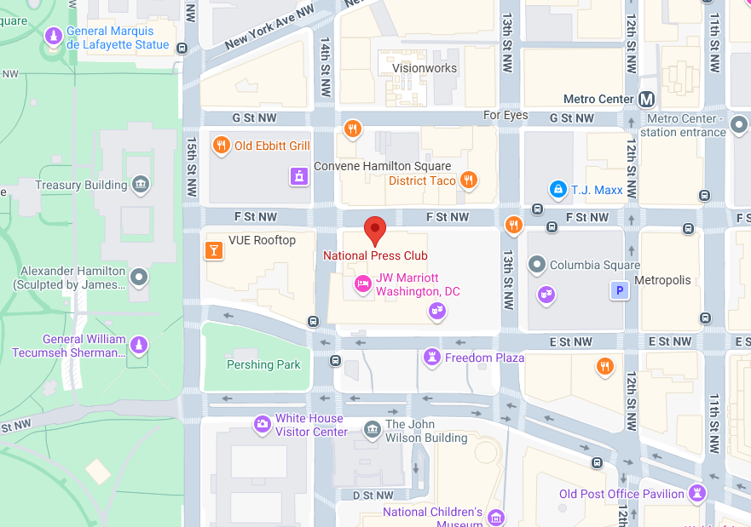
REVEAL SUMMIT UPDATE
Date/time: 8 October 2025, 12 Noon – 4 PM
Venue: National Press Club Ballroom
529 14th St NW, Washington, DC 20045
Registration: link available mid-June
“DRAFT” Agenda

Slide 28
16-17 APRIL TSC MEETING ASHBURN, VA
Major discussion topics:
Reduce DoD footprint
Raise capital
Identify ways to distribute Lead Developer Tasks
TSC Roles & Responsibilities
Establish Priorities
Near-term sponsor prospects/capture
MCP – Jim Cabral
Global Justice – Jim Cabral
EY - Brad Bolliger, Paul Wormeli
Measures for Justice – Brad Bolliger , Pau Wormeli
Code For America – Brad Bolliger
Senzing – Brad Bolliger
Committed $2k for open-source tool
NLETS – Paul Wormeli
NIST – Jennifer Stathakis
APCO/NENA – Ashwini Jarell
AT&T/FirstNet – Ashwini Jarell
NATO CIS /CAP1 – Katherine Escobar
DHS Standards Office– Kamran Atri
Notes:
Reduce DOD Footprint
Transition responsibilities among sponsoring organizations & committees
Share DOD technical resources/support
Share DOD management support/roles and responsibilities (NMO)
Broadly realign NIEMOpen governance, roles and responsibilities at committee level
Stand up workgroup to consider alternatives and present to PGB
Raise Capital:
Diversify funding sources.
Reduce historical reliance on DOD and other Federal partner largesse.
Emphasized the need for broad NIEMOpen participation in cultivating sponsors, focus on maintaining current sponsors and identifying and onboarding new sponsors.
13 near tear sponsor prospects identified, capture managers assigned, ~ 330K near term budget plus-up.
Pursue monetizing NIEMOpen services – training & tech support.
Investigate feasibility of establishing a requirement for new domain organizations to become sponsors and pay instantiation fee.
Pursue Congressional line item in budget in consonance with new Administration focus on Federal interoperability.
Establish Priorities
Decrease DOD Footprint.
Approve NDA PSD01 & Model Version 6.0 PS02
Finish tooling.
CMF Tool
API 2.0 + model management tasks as feasible
MEP tool compatibility with API 2.0 and Model Version 6.0.
Identify and secure near-term sponsorship and funding for tech support.
Capture PGB support for 100K tech bridge funds.
Develop COAs for NBAC, NTAC, NMO to reduce DOD footprint and ameliorate Lead developer tasks.
Articulate new Vision highlighting new NDR, model version and tooling as marketing tool.
Develop view of future NIEM architecture incorporating knowledge graph and AI technologies.
Explore methodologies of comporting other standards with NIEM.

Slide 29

LearnPress LEARNING MANAGEMENT SYSTEM (LMS)
Status: NIEMOpen LMS Supporting 6.0
Beta Class held 6-8 May
Currently 28 Lessons / 27 Quizzes
Each Lesson under 30 min
Developer level track (XML) done
Hosting on NIEMOpen.org/learn
Future work to include:
Executive level track (June 30)
JSON developer track
Updated content for NIEM Toolbox which includes CMF
Analytics
Features Video + Knowledge Checks
Notes:
21 Registrants
MITRE, MIlOps, FBI, EY, etc.
Need to improve login design/ kind of clunky out of the box
Some questions are being moved to other modules thanks to feedback from Beta participants
JSON videos were not completed and GTRI will resume once funding is approved
The Toolbox and CMF were not complete at the time of the recordings and will need to be recorded at later date

Slide 30
TSC Working Group (WG) Progress
Kickoff meeting 2 May 2025
Members:
Mike Hume
Brad Bolliger
Paul Wormeli
Jim Cabral
Jim Herbert
Kamran Atri
Thomas Krul
Stephen Sullivan
Beth Smally
Darcy Staley
Katherine Escobar
David Kemp
2 Major near-term WG issues
How to raise capital
How to distribute technical model maintenance and update responsibilities to include:
Model maintainer
Harmonization process lead
Domain content QA
Configurations control
Model change management documentation
Specification & model release process

Slide 31
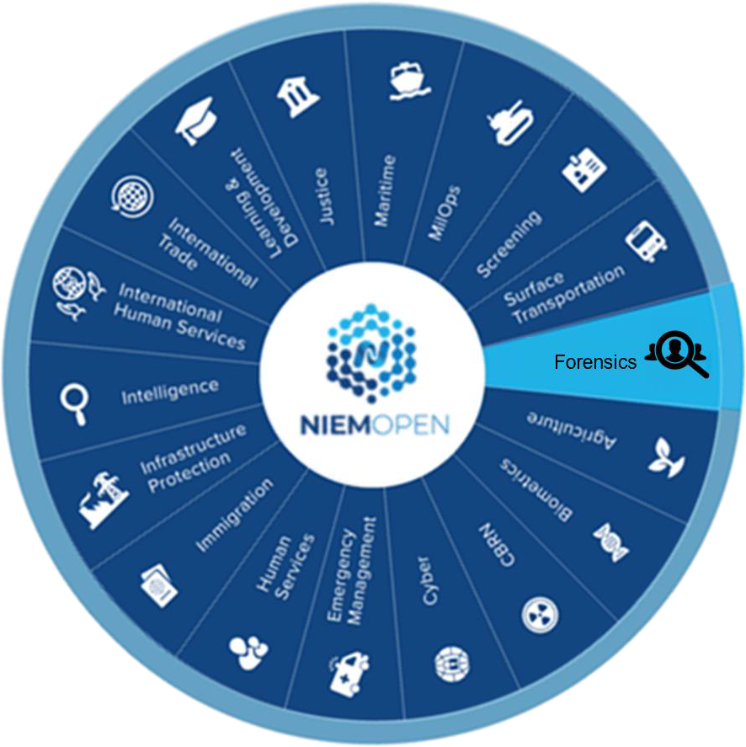
Defense Forensics and Biometrics Agency
OASIS NIEMOpen Forensics Sub-Committee
Proposing OASIS NIEMOpen Forensics Sub-Committee
Unclassified

Slide 32

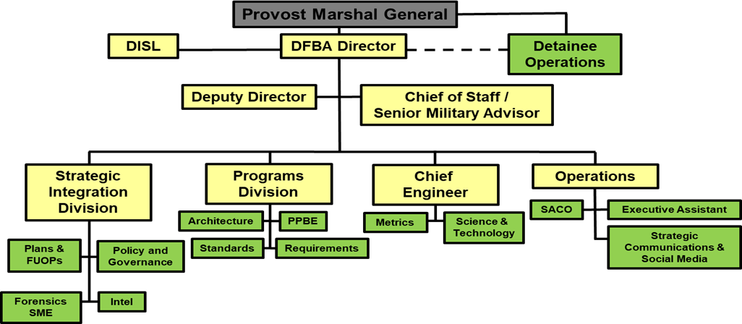
About DFBA
The Defense Forensics and Biometrics Agency (DFBA) is a Direct Reporting Unit (DRU). DFBA’s mission is to lead, consolidate and coordinate forensics and biometrics activities and operations for the Department of Defense in support of identity operations.
DFBA carries out the DoD Executive Agent responsibilities for both forensics and biometrics on behalf of the Secretary of the Army and the Provost Marshal General.
DFBA coordinates data-sharing between U.S. government agencies and foreign nations, as well as other
executive duties.

Slide 33
DFBA Standards Functions
Advocate DoD interest, facilitate formal adoption, provide consistent implementation guidance, and accelerate the development of forensic and biometric standards both nationally and internationally on behalf of the DoD Forensic and Biometric Enterprises in order to enhance interoperability among joint, interagency, international and multinational (JIIM) partners.
Champion Forensic and Biometric standards development across USG and international levels in order to develop, revise, and give guidance on all Forensic and Biometric Standards to be used by the DoD.
Work to ensure that Biometric and Forensic capabilities are developed to be interoperable with existing
capabilities, both internal and external to the DoD.
Coordinate and collaborate with the various DoD entities, interagency communities, and foreign mission partners in order to facilitate consistent adoption and implementation of Forensic and Biometric Standards. Provide subject matter expertise and maintain situational awareness of new technologies.
Submit recommendations for formal DoD adoption of published standards to DoD and IC Joint Enterprise Standards Committee for review and approval
3

Slide 34


NIEMOpen Experience
DoD Electronic Biometric Transmission Specification (DoD EBTS) 4.1
Standard for exchanging biometric data between DoD systems
NIEM conformant
Based on ANSI-NIST-ITL
NIEMOpen Biometrics Domain Co-Chair
Members of NIEMOpen MilOps Community of Interest
Members of NBAC and NTAC
Conformance Testing
Biometric Interoperability and Standards Compliance
Office (BISCO)

Slide 35
NIEMOpen Forensics Sub-Committee Value Proposition
Increase interoperability across DoD, DHS, FBI, and other organizations that exchange forensic information
Increase use of forensics common and standard data and information sharing model for the forensics community
Promotes efficient and consistent data sharing between forensics organizations by maintaining a common vocabulary for forensics attributes
Broadens accessibility of forensics information to Other NIEMOpen sub-committee members
Promotes forensics community-based agreements on Data Element names and definitions and code list
Future consideration for NATO Forensics efforts
5

Slide 36
NIEMOpen Forensics Sub-Committee Data Element Overview
Initial Delivery Data Elements
Initial Delivery
119 Forensics Initial Minimum Data Elements (MDE)
16 Forensics initial MDE mapped to NIEMOpen
103 Forensics initial MDE inclusion into NIEMOpen (want-list)
Total Data Elements
1316 Total Forensics data elements
389 Forensics data elements mapped to NIEMOpen
927 As-is Forensics data elements for inclusion into NIEMOpen (Want-List)
The majority of the Forensic data elements mapped to NIEMOpen belong to the following Domains:
NIEM Mapped NIEM Want-List
Total Data Elements
NIEM Core (136)
Military Operations (124)
Justice (58)
CBRN (29)
MDE = Minimum Data Element
Want-List = List of attributes requiring standardization for
input into OASIS
NIEM Mapped
NIEM Want-List
6

Slide 37
NIEMOpen Forensics Sub-Committee Next Steps
Establishing a business need and formal NIEM model functional area
Open Project Rules
This version of the OASIS Open Project (OP) Rules was approved by the OASIS Board of Directors on 14 June 2022 and became effective immediately. The change was announced to OASIS members on 01 July 2022
in https://lists.oasis- open.org/archives/members/202207/msg00000.html Tabl e of Contents 1. Purpose of Open Projects 2. Project Formation 3. Roles of Parties in the […]
www.oasis-open.org
e-CLA and I-CLA (Contributor License Agreement)
Establishes the organization, governance, rules, and processes for their CoI (i.e. Drafting a governance doc) to manage the model content associated with the Forensics Sub-Committee
Attending NBAC meetings
Preparing a brief for the NBAC
Actual content can be worked on, before hand, in parallel or after creating the Sub-Committee
Notifying OASIS PGB
Registering for NIEMOpen mailing lists
Reviewing OASIS lightweight rules: https://www.oasis-open.org/policies- guidelines/open-projects-process/
Review NBAC governance doc
7

Slide 38
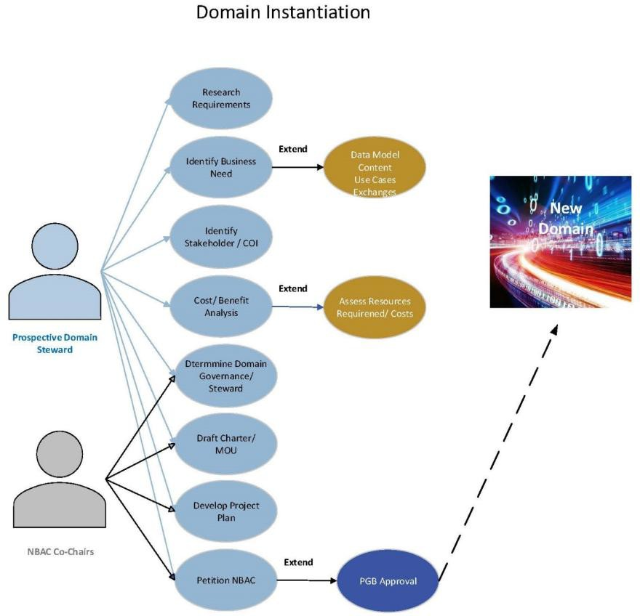
NIEMOpen Forensics Sub-Committee Operational Responsibilities
Sub-Committee Instantiation
Finalize governance document
Create standard operating procedures
Appoint Chair/Co-Chairs = Chair is Ryan Triplett
Appoint NBAC TSC voting members
Maintain a roster
Schedule and hold public meetings
Conduct a kickoff meeting
Conduct sub-committee business
Technical - create model and exchanges – Work in progress
Technical - participate in harmonization and model version cycle
activities
Conduct outreach to stakeholders.
8

Slide 39


Defense Forensics and Biometrics Agency
Standards Branch Chief:
Ryan Triplett
Ryan.L.Triplett.civ@army.mil
Project Lead:
Elena Harner Elena.N.Harner.ctr@army.mil
NIEM SME:
Kamran Atri katri@A4Safe.com Michael Simcock msimcock@A4Safe.com
9

Slide 40

BREAK

Slide 41
Motions
PGB TOPICS FOR CONSIDERATION & VOTE
Motion to authorize $ 1000 from the NIEMOpen general fund for Excellence Awards and “swag” at the NIEMOpen Reveal on 8 October 2025.
Motion to authorize $ 1500 from the NIEMOpen general fund for refreshments, snacks & video services at the NIEMOpen Reveal on 8 October 2025.
Motion to authorize $100K from the NIEMOpen general fund to procure technical services under the INDEPENDENT CONTRACTOR AGREEMENT between OASIS Open and Georgia Tech Applied Research Corporation.
Motion to authorize $ 2100 from the NIEMOpen general fund for purchase of Yoast ($100/annual) and Constant Contact and Marketing ($2000/annual) subscriptions.
Motion to advance the NIEM Naming & Design Rules (NDR) v6.0 Project Specification Draft 01 (PSD01) to a Project Specification (PS).
Motion to identify 3 Statements of Use (SoU) for Model Version 6.0 PS02 and submit SoUs to the PGB.

Slide 42
Motion to authorize $ 1000 for Excellence awards & swag to support the NIEMOpen reveal
Chair: A proposal to authorize $ 1000 from the NIEMOpen general fund for Excellence Awards and “swag” at the NIEMOpen Reveal on 8 October 2025 was submitted as a readahead to PGB Voting Members..
Maker: (NMO – Ms. Beth Smalley) I motion that $ 1000 from the NIEMOpen general fund be authorized for the purchase of awards and swag for the 2025 NIEMOpen Reveal.
SECOND?
Chair: (Debate) Do any of the members have comments on the proposal?
Chair: Conducts a Simple Majority Vote
Chair: Announces Vote
Resolution
?
Approve
Approve w/Comment
Table/Reject
Notes:
1. The member (Beth Smalley) addresses the chair – “Madam Chairman”
2. The chair recognizes the member – “The chair recognizes Beth Smalley”
3. The member (Maker-Beth Smalley) makes a motion: ) I motion that $ 1000 from the NIEMOpen general fund be authorized for the purchase of awards and swag for the 2025 NIEMOpen Reveal.
4. Another member seconds the motion – SECOND
5. Chair: “It is moved and seconded to adopt the motion.
6. The members debate the motion
7. Chair: Those in favor of adopting the motion to approve say ‘Aye.’ [pause] Those opposed, say ‘No.’”
8. Chair: Announce the result
If no objections
Chair: Without objection, approved

Slide 43
Motion to authorize $ 1000 for refreshments & snacks to support the NIEMOpen reveal
Chair: A proposal to authorize $ 1000 from the NIEMOpen general fund for refreshments and snacks at the NIEMOpen Reveal on 8 October 2025 was submitted as a readahead to PGB Voting Members..
Maker: (NMO – Ms. Beth Smalley) I motion that $ 1000 from the NIEMOpen general fund be authorized for refreshments and snacks for the 2025 NIEMOpen Reveal.
SECOND?
Chair: (Debate) Do any of the members have comments on the proposal?
Chair: Conducts a Simple Majority Vote
Chair: Announces Vote
Resolution
?
Approve
Approve w/Comment
Table/Reject
Notes:
1. The member (Ms. Beth Smalley) addresses the chair – “Madam Chairman”
2. The chair recognizes the member – “The chair recognizes Beth Smalley”
3. The member (Maker-Ms. Beth Smalley) makes a motion: ) I motion that $ 1000 from the NIEMOpen general fund be authorized for the purchase of refreshments & snacks for the 2025 NIEMOpen Reveal.
4. Another member seconds the motion – SECOND
5. Chair: “It is moved and seconded to adopt the motion.
6. The members debate the motion
7. Chair: Those in favor of adopting the motion to approve say ‘Aye.’ [pause] Those opposed, say ‘No.’”
8. Chair: Announce the result
If no objections
Chair: Without objection, approved

Slide 44
Rationale for funding tech support
Background
Current GTRI subcontract with BAH expired 10 May with no DoD follow-on funding going forward
GTRI activities under BAH subcontract included:
NDR v6.0 PSD01 support – NDR approved by PGB
Complete Model Version 6.0 PS02 – approved by PGB
Complete API 2.0 user features
Update training to reflect Version 6.0 NDR and NIEM Model
Need
Tech support beyond NTAC volunteers needed:
Complete API 2.0 model management features
Maintenance and model management support v6.1
USMTF & EMS MilOps content QA
Forensics and Analytical Laboratories domains’ content QA
NIEM Toolbox updates

Slide 45
DRAFT work order Deliverables SYNOPSIS
1. Plan, coordinate, and execute the next annual NIEMOpen model release (6.1) in coordination with the NTAC and NBAC.
Manage and update the NIEMOpen model
Generate schemas, documentation, and other supporting artifacts for the release, as directed by the PGB. (Minor version 6.1 PSD01 is the target for this Work Order, with a target release date of summer 2026, subject to the timing of domain inputs, level of effort, and prioritization by PGB.)
2. Collect, track, and document NIEMOpen issues not included in version 6.1 for consideration for future releases through NBAC
3. Host and publish all 6.1 related artifacts on NIEMOpen repos

Slide 46
DRAFT work order Deliverables SYNOPSIS (cont.)
4. Update NIEM API 2.0 to add model management functionality:
QA of change requests and the NIEMOpen model release
Automate updates to database content,
Automate generation of model release artifacts (e.g. schemas, change log, statistics report, CSV files)
Integrate with the latest version of the Common Model Format (CMF) tool
Update the NIEM Toolbox user interface to accommodate these new/improved functionalities.
5. Update NIEMOpen technical training material to reflect:
New NIEM Toolbox functionality
Updates based on new message specification guidance from the NTAC,
NDR 6.0 changes
NIEM JSON support.\
6. POP 12 months

Slide 47
Motion to authorize $ 100K to procure Technical contract services for niemopen
Chair: A proposal to authorize $ 100K from the NIEMOpen general fund be used to procure technical services under the INDEPENDENT CONTRACTOR AGREEMENT between OASIS Open and Georgia Tech Applied Research Institute (GTRI) Corporatio was submitted as a readahead to PGB Voting Members.
Maker: (NMO – Ms. Beth Smalley) I motion that $ 100K from the NIEMOpen general fund be used to procure technical services for NIEMOpen and that the PGB Chair & NIEM Management Office work with OASIS Open and GTRI to define an agreed upon Work Statement.
SECOND?
Chair: (Debate) Do any of the members have comments on the proposal?
Chair: Conducts a Simple Majority Vote
Chair: Announces Vote
Resolution
?
Approve
Approve w/Comment
Table/Reject
Notes:
1. The member (Ms. Beth Smalley) addresses the chair – “Madam Chairman”
2. The chair recognizes the member – “The chair recognizes Beth Smalley”
3. The member (Maker-Ms. Beth Smalley) makes a motion: ) I motion that $ 100K from the NIEMOpen general fund be used to procure technical services for NIEMOpen and that the PGB Chair & NIEM Management Office work with OASIS Open and GTRI to define an agreed upon Work Statement.
4. Another member seconds the motion – SECOND
5. Chair: “It is moved and seconded to adopt the motion.
6. The members debate the motion
7. Chair: Those in favor of adopting the motion to approve say ‘Aye.’ [pause] Those opposed, say ‘No.’”
8. Chair: Announce the result
If no objections
Chair: Without objection, approved

Slide 48


Motion to Approve purchase of YOAST and Constant Contact Email & marketing Subscriptions
Chair: A proposal to approve purchase of Yoast SEO plugin and Constant Contact Email subscriptions an renew annually as funds permit was presented as readahead to the PGB.
Maker: (NMO-Beth Smalley) I motion that NIEMOpen approve purchase of Yoast SEO plugin and Constant Contact Email and Marketing subscriptions and renew annually as funds permit.
Yoast SEO simplifies site optimization, boosts organic traffic, and saves time on SEO tasks
$100/annual
SECOND?
Chair: (Debate) Do any of the members have comments on the proposal?
Chair: Conducts a Simple Majority Vote
Chair: Announces Vote
Digital tools:
Email marketing
Social Media marketing
Event marketing
AI
Automation
$2000/annual
Resolution
?
Approve
Approve w/Comment
Table/Reject
Notes:
1. The member (Darcy Staley) addresses the chair – “Madam Chairman”
2. The chair recognizes the member – “The chair recognizes Darcy Staley”
3. The member (Maker-Beth Smalley) makes a motion – I motion the PGB approve the following proposal:
Purchase Yoast SEO plugin and Constant Contact Email and Marketing Services subscriptions and renew annually as funds permit.
4. Another member seconds the motion – SECOND
5. Chair: “It is moved and seconded to adopt the motion.
6. The members debate the motion
7. Chair: Those in favor of adopting the motion to approve say ‘Aye.’ [pause] Those opposed, say ‘No.’”
8. Chair: Announce the result
If no objections
Chair: Without objection, approved

Slide 49
Motion to advance the NIEM NAMING & Design rules (NDR) Project specification draft 01 (PSD01) to A project specification (PS)
Chair: A proposal to advance the NIEM NDR v6.0 PSD01 to PS was submitted as a readahead to PGB Voting Members.
Maker: (NTAC – Dr. Scott Renner) I motion that the NIEMOpen Technical Architecture Committee (NTAC) work to advance the NIEM NDR v6.0 PSD01 to a PS and submit to the PGB for review and vote.
SECOND?
Chair: (Debate) Do any of the members have comments on the proposal?
Chair: Conducts a Simple Majority Vote
Chair: Announces Vote
Resolution
?
Approve
Approve w/Comment
Table/Reject
Notes:
1. The member (Dr. Scott Renner) addresses the chair – “Madam Chairman”
2. The chair recognizes the member – “The chair recognizes Beth Smalley”
3. The member (Maker- Dr. Scott Renner) makes a motion: ) I motion that the NIEMOpen Technical Architecture Committee (NTAC) work to advance the NIEM NDR v6.0 PSD01 to a PS and submit to the PGB for review and vote.
4. Another member seconds the motion – SECOND
5. Chair: “It is moved and seconded to adopt the motion.
6. The members debate the motion
7. Chair: Those in favor of adopting the motion to approve say ‘Aye.’ [pause] Those opposed, say ‘No.’”
8. Chair: Announce the result
If no objections
Chair: Without objection, approved

Slide 50
Motion for the ntac, nbac & nmo to collectively identify a minimum of 3 statements of use for niem model version 6.0
Chair: A proposal for the NTAC, NBAC, & NMO to collectively identify a minimum of 3 Statements of Use (SoU) for NIEM Model Version 6.0 PS02 was submitted as a readahead to PGB Voting Members.
Maker: (NBAC – Mr. Thomas Krul) I motion that the NTAC, NBAC, & NMO collectively identify a minimum of 3 Statements of Use (SoU) for NIEM Model Version 6.0 PS02 and submit IAW the OASIS Lightweight Rules to the PGB for review and approval .
SECOND?
Chair: (Debate) Do any of the members have comments on the proposal?
Chair: Conducts a Simple Majority Vote
Chair: Announces Vote
Resolution
?
Approve
Approve w/Comment
Table/Reject
Notes:
1. The member (Mr. Thomas Krul) addresses the chair – “Madam Chairman”
2. The chair recognizes the member – “The chair recognizes Beth Smalley”
3. The member (Maker- Mr. Thomas Krul) makes a motion: ) I motion that the NTAC, NBAC, & NMO collectively identify a minimum of 3 Statements of Use (SoU) for NIEM Model Version 6.0 PS02 and submit IAW the OASIS Lightweight Rules to the PGB for review and approval.
4. Another member seconds the motion – SECOND
5. Chair: “It is moved and seconded to adopt the motion.
6. The members debate the motion
7. Chair: Those in favor of adopting the motion to approve say ‘Aye.’ [pause] Those opposed, say ‘No.’”
8. Chair: Announce the result
If no objections
Chair: Without objection, approved

Slide 51
UPDATES
TSC Updates
NTAC Update – Mr. Brad Bolliger & Dr. Scott Renner
NBAC Update – Kamran Atri
NMO Update – Beth Smalley

Slide 52
NTAC TSC UPDATE
NIEM NDR v6.0 PSD01 approved by PGB
NIEM Model v6.0 PS02 approved by PGB
CMF Tool
NEXT: Advance NIEM NDR v6.0 PSD01 to PS

Slide 53
NBAC TSC UPDATE
Obtain Statements-of-Use for NIEM Model v6.0 PS02
Onboard:
Forensics Domain/Sub-Committee
Analytical Laboratories Domain/Sub-Committee
Identity Management Domain/Sub-Committee
Assist Defense Forensics with content contributions

Slide 54
NMO TSC UPDATE
Hosted TSC Co-Chairs’ meeting 16-17 April
Conducted LMS training/ test 6-8 May
Implements NDR and NIEM Model Version 6.0
Raise Capital
Sponsorship (April Meeting capture list & continuing work with OASIS Business Development)
Monetizing services
Training
Tech Support
TSC Working Group (WG) Recommendations –TBD
Reduce DoD Footprint
Transition
Update TSC Roles and Responsibilities/Governance – tasked to TSC WG
NIEMOpen Reveal, 8 October @ NPC 8 AM-12 Noon
NIEM Excellence Awards
How to nominate, due dates
NIEMOpen Future
Vision
Good News Stories
v6.0 NDR & Model
Major Milestone - Poised to advance NIEM Model specification to OASIS Standard (OS)
New Tooling (CMF, API 2.0, MEP)
Forward Looking:
Support for AI, ontologies, knowledge graphs
Efficient collaboration with other models/standards
46

Slide 55








RESOURCES
Follow Us On Twitter
https://twitter.com/NI EMconnects?ref_src=t wsrc%5Etfw
Katherine Escobar, katherine.b.escobar.civ@mail.mil, 757-203-8631
Git Repos
https://www.niem.gov/
https://www.linkedin.c om/groups/1903175/p rofile
NIEMOpen: https://github.com/niemopen/
NTAC TSC
https://github.com/niemopen/ntac-admin
NBAC TSC
https://github.com/niemopen/nbac-admin
NMO TSC
https://github.com/niemopen/nmo-admin
•
NIEMOpen Slack Channel: https://niemopen.slack.com/
https://niemopen.org/
https://www.youtube. com/channel/UCg9qV 22PXLBjG41hc-EwVrQ
IEPD/MEP REPO
Mailing Lists
MEP TOOL
NIEMOpen: https://lists.oasis-open-projects.org/g/niemopen
PGB: https://lists.oasis-open-projects.org/g/niemopen-pgb
NTAC TSC: https://lists.oasis-open-projects.org/g/niemopen-ntactsc
NBAC TSC: https://lists.oasis-open-projects.org/g/niemopen-nbactsc
NMO TSC: https://lists.oasis-open-projects.org/g/niemopen-nmotsc
CMF TOOL
NDR v6.0 PSD01
NIEM Model v6.0 PS02

Slide 56
PGB MEETING SCHEDULE
NEXT PGB Meeting
Thursday, 31 July 2025
Virtual Meeting 2 – 4 PM EDT
– Virtual: MS TEAMS
CY 2025 Meeting Dates Revised
Q4 | NOV 13 | 2 – 4 PM | EDT

Slide 57

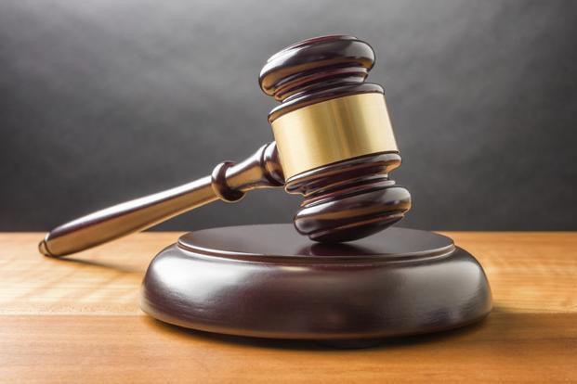
ADJOURN
Chair: Do any of the PGB members or our attending guests have any questions?
Chair: Meeting Adjourned

Slide 58
BACKUPS

Slide 59











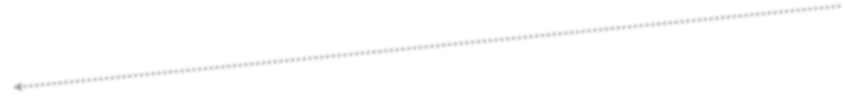



SPECIFICATION WORKFLOW AND TIMELINE
Request a spec template from OP Admin
Decide on editor(s)
Editor’s job is to capture the intentions of the project team/TSC
Editor’s Manual starting at https://docs.google.com/document/d/1lTartcAzlqidzrCxuXFFiwdRDKRipqMnNsMS24SZdjg/edit
Create Project Specification Draft (PSD)
PGB can decide to advance PS to OASIS for consideration as an OASIS Standard
Requires 3 Statements of Use and a Special Majority Vote run by OP Admin
60-day public comment period
The Project Specification (PS) is put to OASIS Members in a 14-day Call for Consent. If no objections, work becomes an OASIS Standard, eligible for submission to other SDOs
PSD produced with oversight of TSCs
TSC recommends PSD to PGB
PGB requests Special Majority Vote be run by OP Administrator
Project Specification Approved by PGB
PGB approve PS as Candidate for OASIS Standard
OASIS Standard approved by members under Call for Consent
PS has the same standing as an OASIS Standard
7 days minimum - 2/3 must vote yes, no more than 1/4 nay votes
OP Admin publishes PS to the
library and announces/promotes
Project Specification Draft(s)^{1,3}
60 Day Public Review/ Comment
DRAFT PSD
PS PGB
Approval²
PS Candidate OS
PGB
Approval²
Call for Consent
OASIS Standard
PGB
2
Approval
14 Days Notice of Vote
14 Days Notice of Vote
3 Statements of Use
GitHub Repo
OASIS Project Library docs.oasis-open- projects.org
Special Majority Vote 7 Days
Working Draft 3-12 Months
Statements of Use 1-6 Months
2-3 Weeks Publish Candidate Standard
60 Days
14 Days
Publication & Announcement 1-2 Weeks
23

